Slide 1

Title I Annual Meeting
2026-2027
Otis A. Mason Elementary
Monique Keaton, Principal
Julie Hudson, Assistant Principal
Elizabeth Dailey, LEA/Assistant Principal
Danie Waler, Title I Parent Liaison

Slide 2
Agenda
Overview of Title I
Use of Title I Funds
Parental Rights
Accountability
Parental Involvement
School Parent Compact
Next Steps

Slide 3

About Title I
Title I is the largest federal assistance program for our nation’s schools.
The goal of Title I is to address the academic needs of students and to assist them in meeting their state’s academic standards.
The program serves 16 schools in St. Johns County including eligible students in 3 non-public schools.
Notes:
7 Elementary

Slide 4
Title I Funding
St. Johns County Schools
Increased Student Achievement
Federal Government
1
3
2
4
Florida Department of Education
Otis A. Mason Elementary
Notes:
The Florida Department of Education receives funds from the federal government. Districts receive Title I funds from Department of Education, and the school district distributes these funds to schools based on the percentage of children eligible for free/reduced price lunch; however, students do not have to be from low-income families to receive help.

Slide 5


Title I Supports Otis A. Mason Elementary
Additional supplemental personnel
Additional Teachers to reduce class size
Supplies
Snacks
Parent Liaison
Tutors
Camps
Parent and Family Engagement Opportunities
Raise Craze!
Trunk or Treat, October 23
Night of the Arts
Bookfairs
Choral Performances
Data Chats
Spirit Nights
And So Much More!

Slide 6
Title I Schoolwide Planning
First
Second
Last
Input from school, family, and community members determine how Title I funds are used based on a needs assessment.
Attend meetings/trainings and complete surveys to provide input on Title I funding.
All Title I schools must document that parents are involved in the schoolwide planning process.

Slide 7
Working Together for Student Success
As a Title I parent you have the right to be involved in the development of the following plans and documents for our school which can be found on our website or available in print upon request.
School Improvement Plan (SIP)
School-Parent-Student Compact
Parent and Family Engagement Plan (PFEP)
Through School Advisory Council (SAC) and parent meetings
Notes:
Explain how you will invite families to provide input for required plans.

Slide 8

Parent’s Right to Know
As a parent of a student attending a St. Johns County Public School, you have the right to…
Be provided information on your child’s level of achievement on assessments in Reading/Language Arts, Writing, Mathematics, and Science.
Request and receive information on the qualifications of your child’s teacher and supplemental personnel working with your child.
Be notified if your child’s teacher is teaching out-of-field.
Be informed if your child is taught by a teachers who does not meet state certification or licensure requirements for four or more consecutive weeks.

Slide 9
Parent-School-Student Compact
The Parent-School-Student Compact is updated every year to include parent, student, teacher, and staff input. Parent, student, teacher and staff comments are welcome at any time during the year.
At Otis A. Mason Elementary School, the compact was shared and discussed in our School Advisory Council meetings, at the Title I Annual Meeting, Meet the Teacher, and Parent Intake Conferences.
This year we are challenging each family to give FIVE HOURS of VOLUNTEER time!
Notes:
The purpose of the compact is to foster student achievement. By signing the Parent-School-Student Compact, Enter School name Elementary, teachers, staff, parents and students agree to work together to share the responsibility of helping students meet or exceed state, district and school academic goals.

Slide 10

Parent and Family Engagement Plan (PFEP)
Title I schools must:
Provide information on how the school works with parents, community, volunteers, and business partnerships to increase student achievement
Provide trainings to staff on effective strategies to engage parents in their children’s education
Provide academic parent trainings designed to increase student achievement
Explain the curriculum, assessments, and the minimum standards that students are required to meet
Notes:
Describes how the school will carry out the parental engagement requirements
Developed jointly with parents
Provide information on the specific committees that parents can be involved. Include the purpose, date and time of meetings.
Explain the PFEP and its purpose.

Slide 11

Accountability
  School Report Cards
  Grade “A” for last six years
  Enrollment 611 (and continue to grow)
  FAST – STAR, PreK – 2
  FAST – Cambium , 3-5
  FSA – Science, 5
  BEST Writing – 4-5
  Assesses – ELA, Math, and Science
  Sub-Groups
  Long-Term Goals and Interim Progress
  VPK earned an EXCELLENT rating!
  Available online at https://edudata.fldoe.org/.
Notes:
Florida Assessment of Student Thinking
Per Pupil Expenditure is $10,669 updated for 22-23

Slide 12
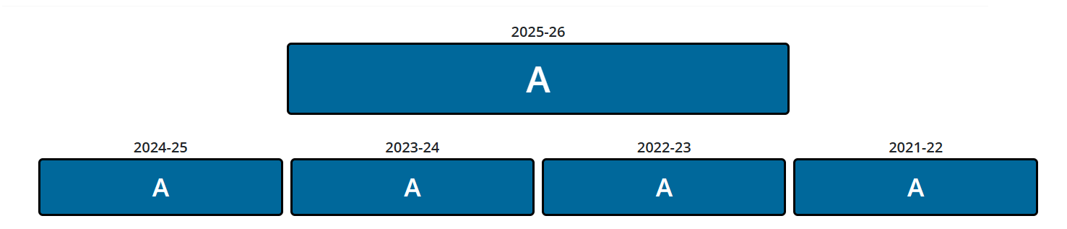
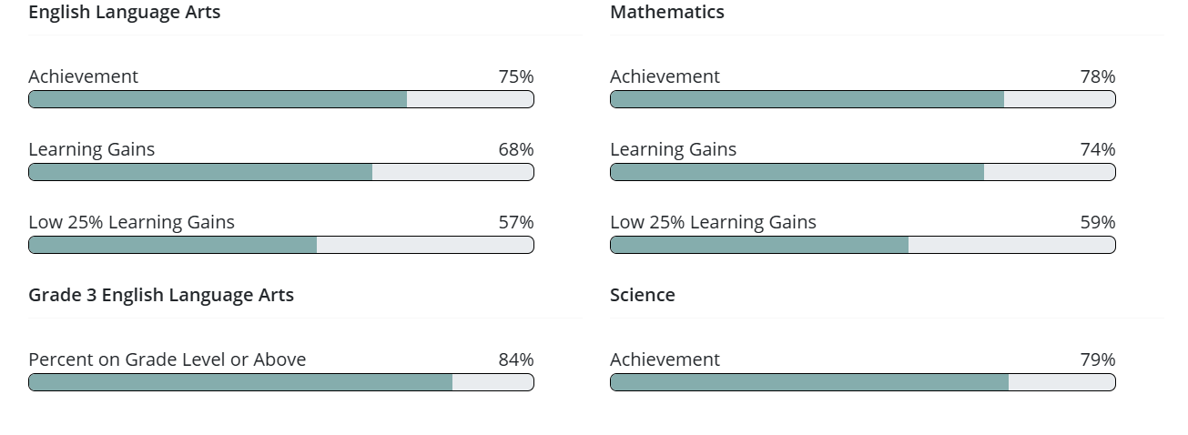
School Data for 2025-2026

Slide 13
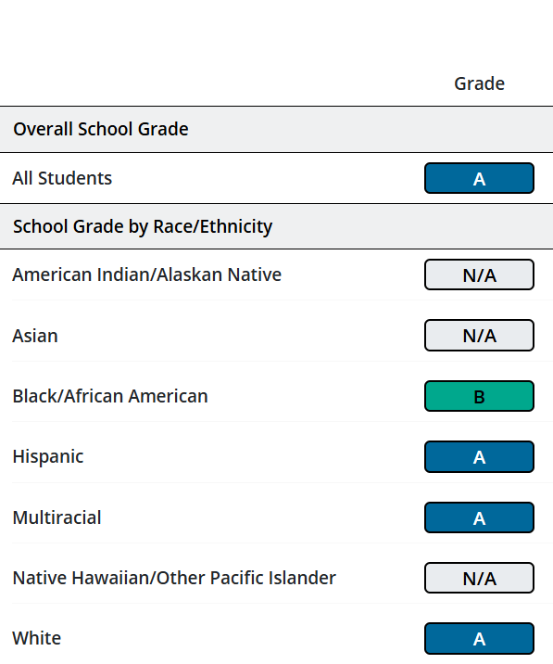
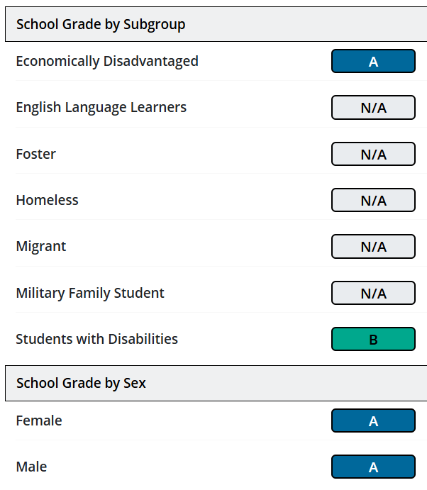
School Data for 2025-2026

Slide 14
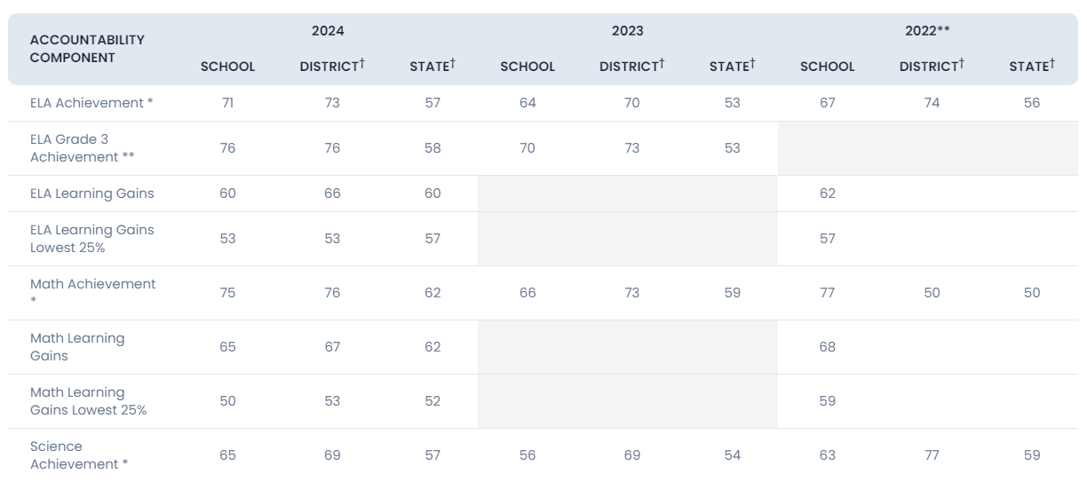
School Data

Slide 15
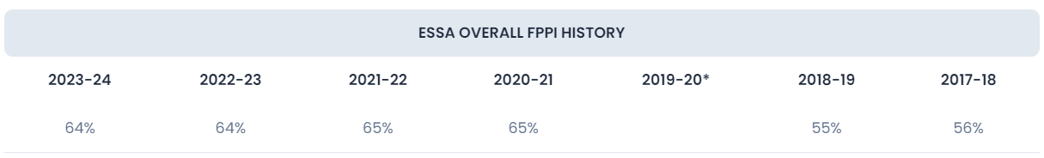
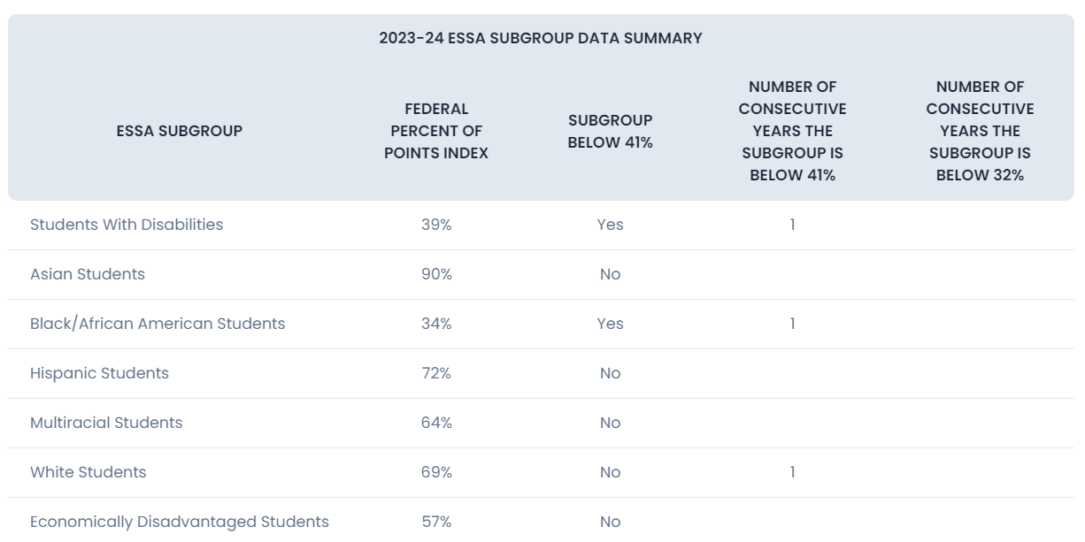

Slide 16
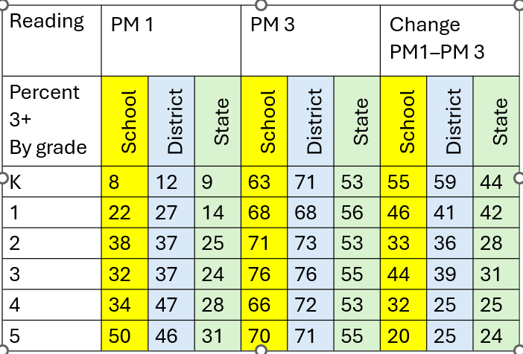
School Improvement Goal, Proficiency

Slide 17
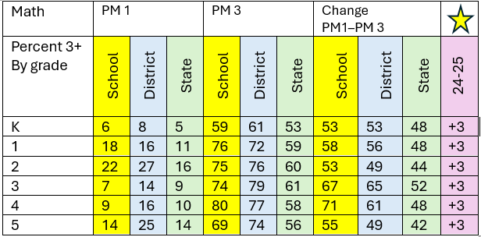
School Improvement Goal, Proficiency

Slide 18

  Florida’s academic content standards establish high expectations for all students.
  Florida Standards identify what your child needs to know and be able to do in all content areas. You may read more information by visiting fldoe.org/academic/standards/.
  Your child’s teacher explained the standards for your child’s grade level during your Intake Conference.
Notes:
All curriculum, instruction and assessments are based on Floirda standards.

Slide 19

Rx Instruction Based on Assessments
PM 1, PM 2, PM 3
STAR Early Literacy
STAR Reading
Cambium
Accelerated Reader
Fundations Unit Tracker
Benchmark Reading
Core Phonics

Slide 20

Working Together for Student Success
Please join us…
In-Take Conferences, “The Mason Experience”
Spirit Nights – Zaxby’s, August
Chipotle, September
Sykes Family Farms, October 10
Texas Roadhouse, November 10
with more to be scheduled
September - Raise Craze PTO Fundraiser
October 15 - Title I Annual Meeting
October 23 - Trunk or Treat
Look for the Monthly Newsletter and School Messenger Communication
And More!
Notes:
Add scheduled Quarter I family events

Slide 21
Next Steps
We encourage
you to…
stay involved through joining SAC, PTO, or volunteering.
communicate with the teachers and other
staff regularly.
participate in giving your input for our SIP, PFEP, and Compact.

Slide 22
Stay Connected With Us!
Important information from your child’s teacher will be shared via email, phone calls, newsletter, and Parent Square.
Be sure to read our school newsletter, OMES-at-a-Glance, each month for updates.
Visit our school website for up-to-date information.
Read our Parent Square messages.
Notes:
Update content based on your school means of communication

Slide 23

Please ensure that your current contact information is on file to stay informed about what’s occurring at your child’s school and in the district. Parents and guardians can receive phone calls, emails and text messages.

Slide 24
Thank You
Monique Keaton, Principal
Julie Hudson, Assistant Principal
Elizabeth Dailey, LEA/Assistant Principal
Danie Waler, Title I Liaison
904-547-8440
Danielle.Waler@stjohns.k12.fl.us
Notes:
Personalize with contact information with Title I representative

