Slide 1
Proctoring In Our Schools
St. Johns County School District
2025-2026

Slide 2
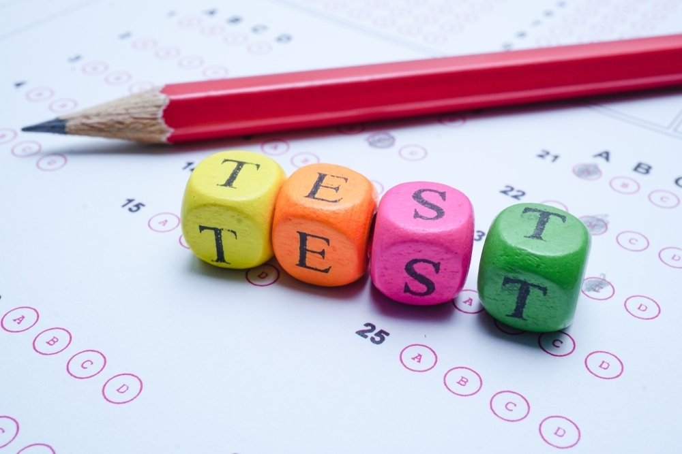
What is a proctor?
A proctor is a person who helps monitor students during an examination.
A proctor assists and supports the test administrator in exam administration, but they are not responsible for the actual test administration.

Slide 3
Who can be a proctor?
Both school/district personnel and non-school/district personnel (volunteers) can serve as proctors, but they have slightly different roles.
School/District Proctor vs. Volunteer Proctor
School/district personnel may assist the test administrator in distributing and collecting secure test materials.
Non-school/district personnel (volunteers) may not participate in any test administration procedures and may not handle any secure testing materials.

Slide 4
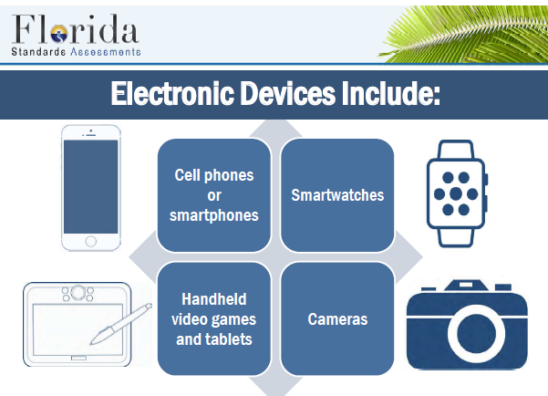
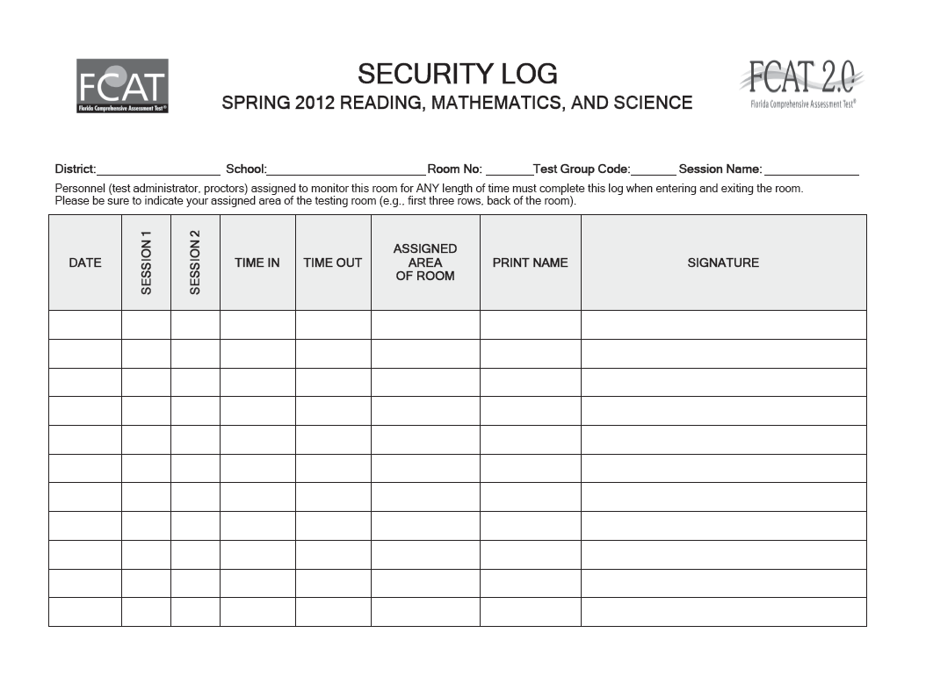
Important Information For All Proctors
All proctors must be trained prior to testing.
All proctors must sign a test security agreement prior to testing.
Proctors should always sign the Room Security Log when entering and leaving the testing room.
Proctors should listen as carefully as the directions are being read to stay just as informed as the students about what they are permitted to do and what they are not permitted to do.
No electronic devices of any kind are permitted to be on the student’s person, desk, or within arm’s reach. This is cause for test invalidation. Please keep a close eye on student backpacks, purses or for any electronic device that may be clipped to their clothing.

Slide 5
What Proctors Do In Testing Rooms
Check to see if the students are working in the correct session of the test, if they are not, report it to the test administrator in the room.
If necessary, circulate quietly among students.
Serve as an “extra set of eyes” in the room to assist the test administrator in monitoring the testing environment.
Check to see if students have only the items needed to complete their test on their desk.
Provide an extra pencil if asked to do so.
Direct any and all issues observed in the room to the test administrator.

Slide 6
What Proctors May NOT Do In Testing Rooms
Proctors may not handle test materials, unless they are a district employee.
A proctor may not serve in a room if a family member is participating in the testing in that room.
Should not directly address any student problems or testing issues. If you suspect there may be a problem, report it to the test administrator in the room immediately.
Should not answer student questions. Excuse yourself and ask the test administrator to assist.
May not use cell phones or other electronic devices. Devices must be on “silent” or turned off during testing and should remain stowed away until testing is complete.

Slide 7
Security Agreement
All proctors are required to:
Read the Florida Test Security Statutes (1008.23 and 1008.24) found on the following slides.
Read the Florida State Board of Education Test Security Rule (6A-10.042) found on the following slides.
Sign and date a security agreement, indicating they have been informed of these rules.

Slide 8
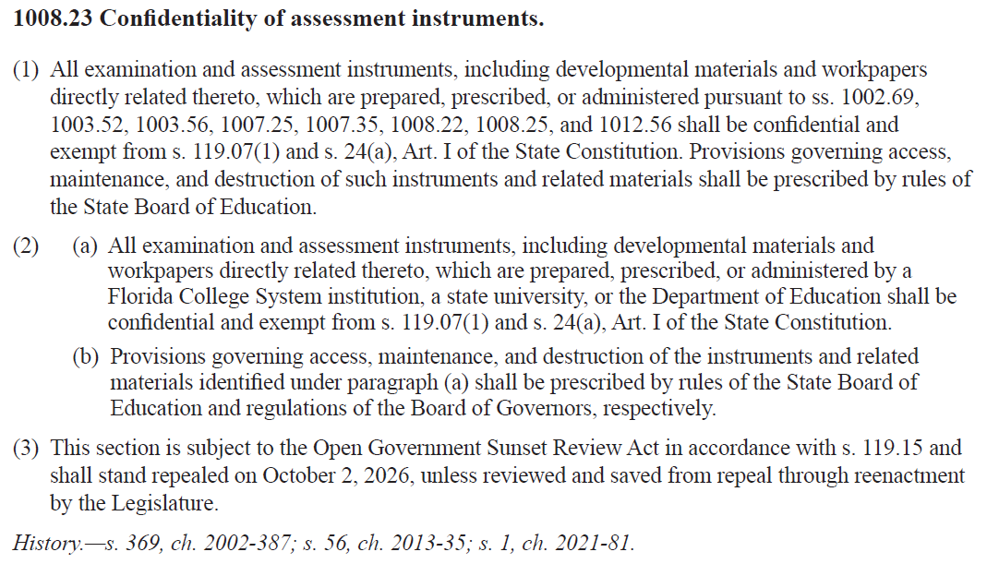
Florida Test Security Statutes

Slide 9
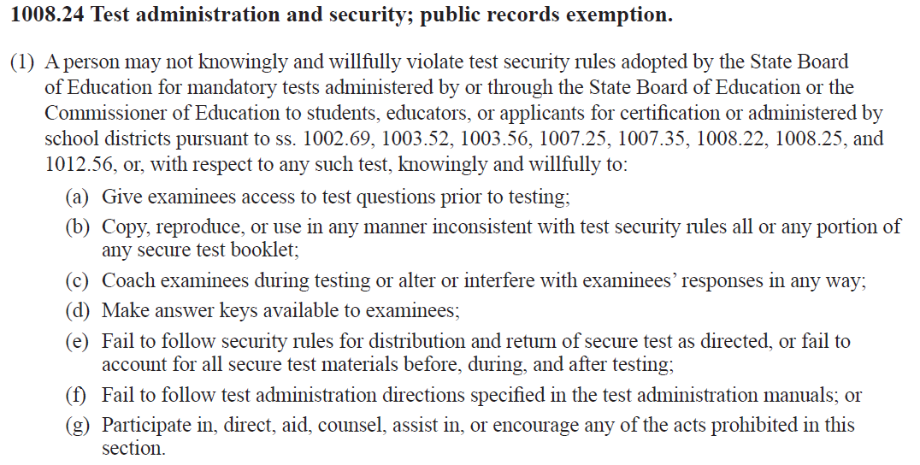
Florida Test Security Statutes (con’t)

Slide 10
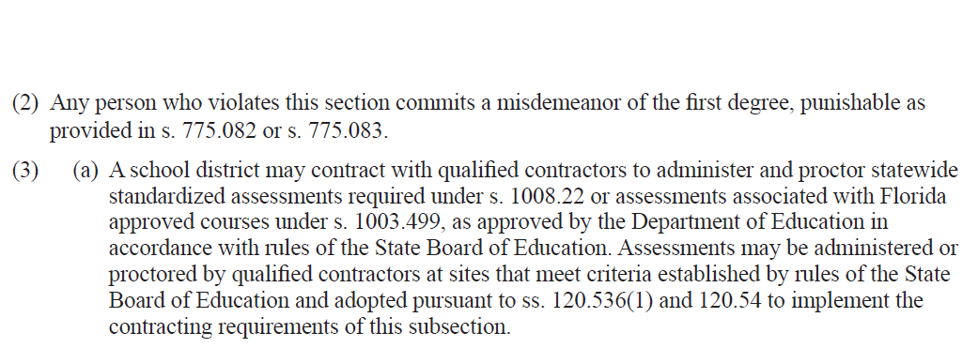
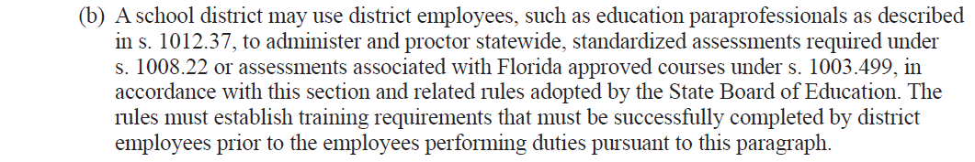
Florida Test Security Statutes (con’t)

Slide 11
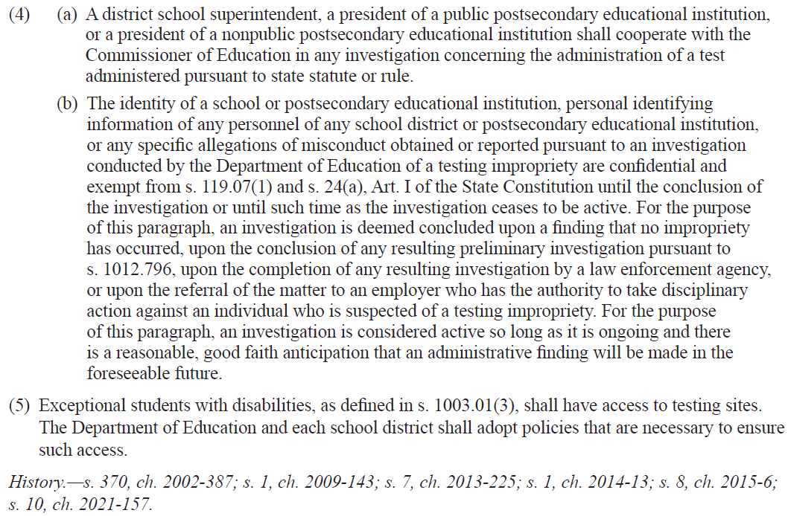
Florida Test Security Statutes (con’t)

Slide 12
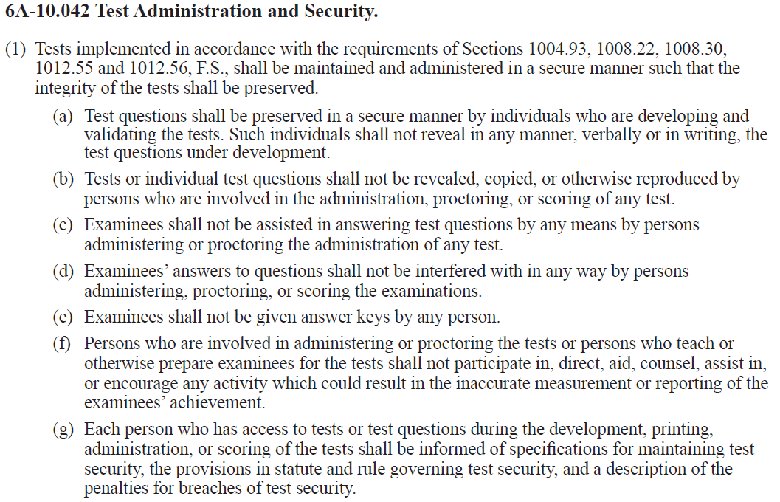
Florida State Board of Education Test Security Rule

Slide 13
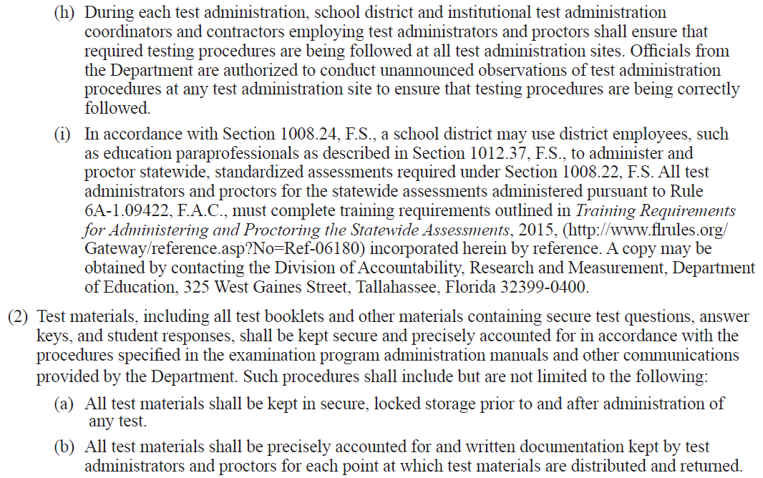
Florida State Board of Education Test Security Rule

Slide 14
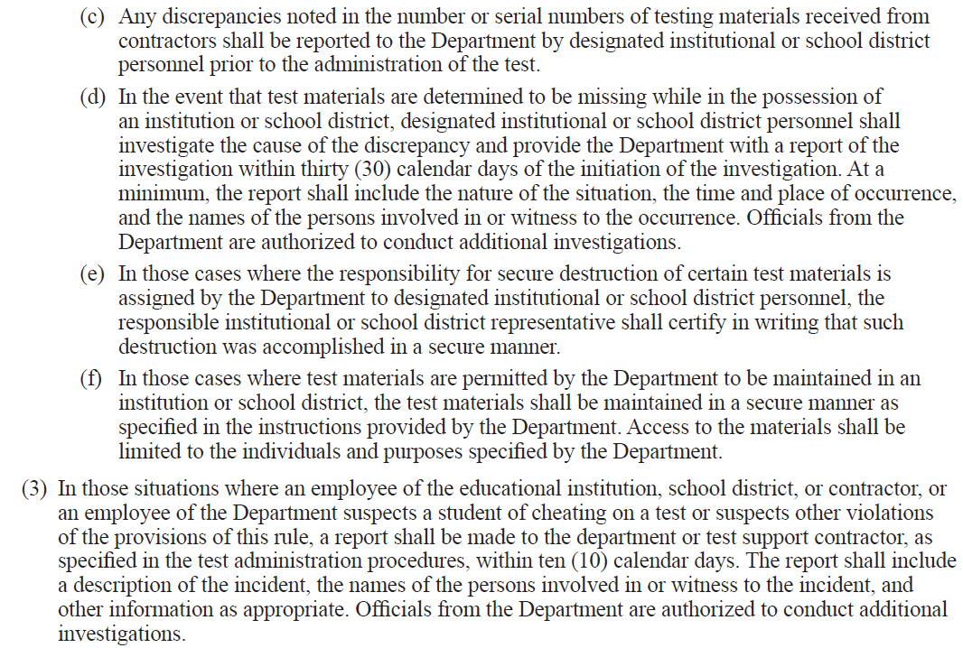
Florida State Board of Education Test Security Rule

Slide 15
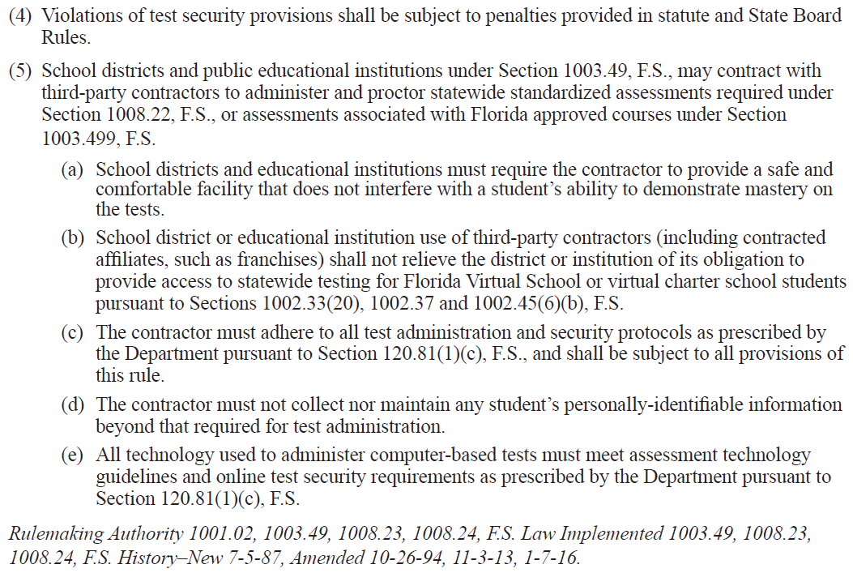
Florida State Board of Education Test Security Rule

Slide 16

Proctoring is an important responsibility and proctors are invaluable in the testing process.
Your help is greatly appreciated.

