Slide 1
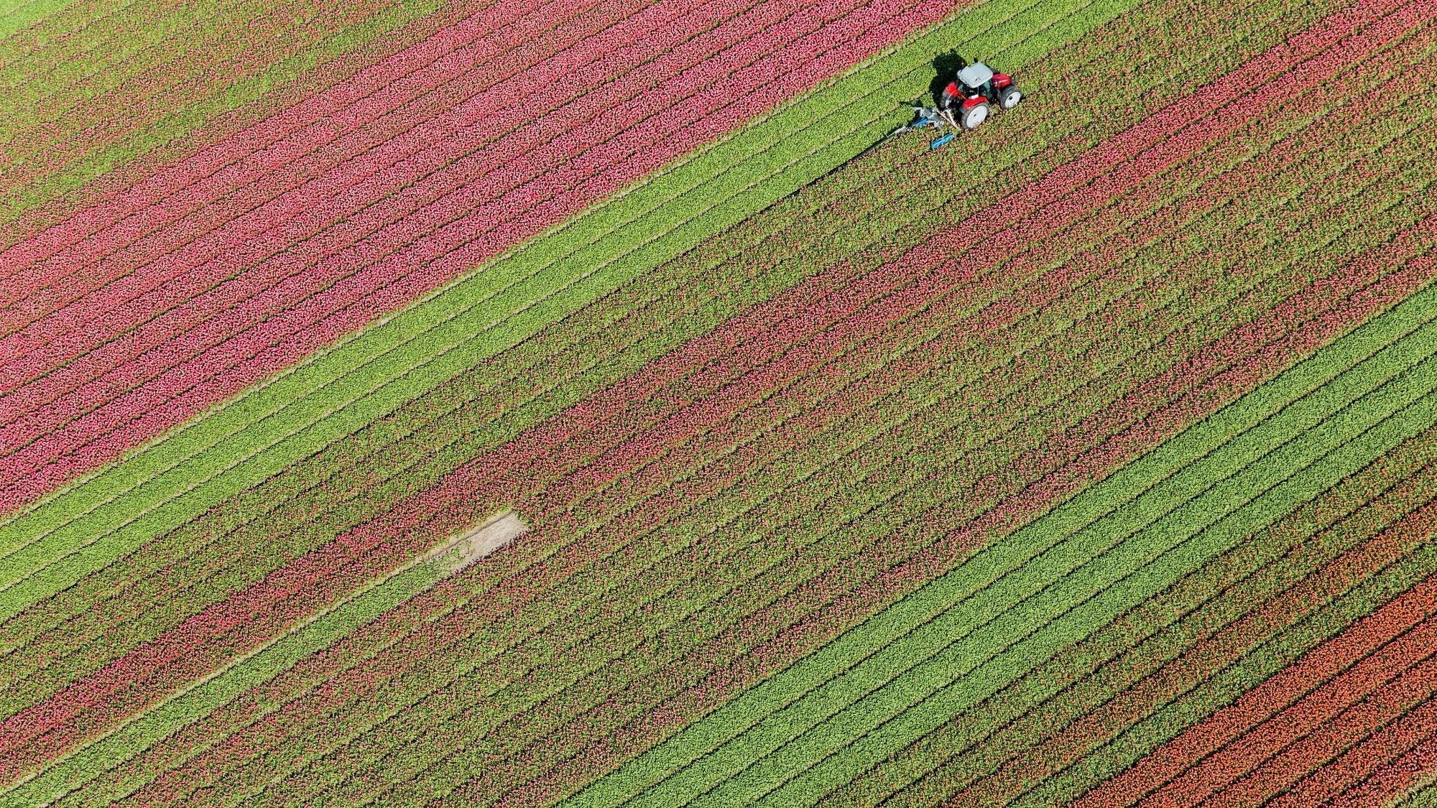
Otis A. Mason Elementary Volunteer Orientation

Slide 2
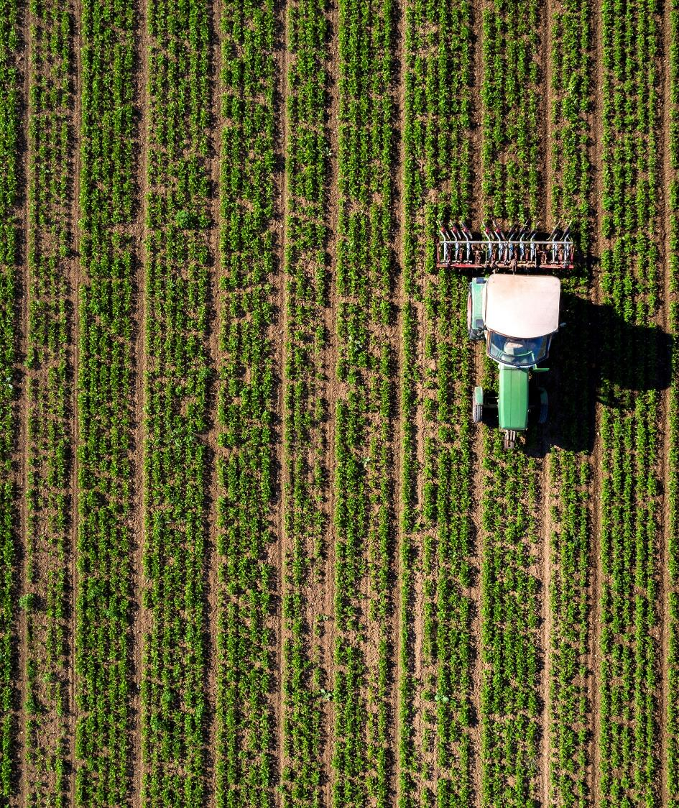
Safety is our Priority We follow all SJCSD and state of Florida safety requirements for schools.

Slide 3
Otis A. Mason Elementary welcomes you! Volunteer Requirements:
Approved Background Check in Raptor-link on our website
Bring photo ID with you
Sign-in when you arrive on campus
Wear badge while on campus
Sign-out and turn in badge when you exit

Slide 4
Before you visit campus:
Plan your visit with the appropriate person-PTO sign up or confirm with a teacher or organizer. All volunteers should be expected.
Please call us if you would like to connect to a volunteer opportunity (they are endless).

Slide 5
While you are here, please remember:
Volunteers should NEVER be alone with an individual student. There is a “two deep rule of supervision”
Please keep your badge on your chest and visible the entire time you are volunteering. Everyone on campus looks for this badge as a sign that you are a safe adult.
Please keep all doors shut and locked on campus. Particularly with outside exit doors, we ask that you double check that doors close behind you.

Slide 6
We kindly ask:
Please do not discipline students. If there is a student concern, please report it to a member of our staff who will deal with the situation.
Stay where you are assigned to volunteer. ALL volunteers should be where they are expected. Please do not visit other classrooms or visit with students without approval.
Do NOT use your cell phone while on campus. We ask that all volunteers be “present” when they are here.
Volunteering should not be used as a way to visit/share custody with your child.

Slide 7

Reminder about Dismissal Changes
Are you volunteering and would like to have your child meet up with you after school?
PLEASE submit a dismissal change so everyone knows in advance and can notify the student and teacher in a timely manner.
All EARLY dismissals should be by 2:15pm and students need to be signed out of the Front Office.
DO NOT leave campus without signing out your child (and yourself!)

Slide 8
At Otis A. Mason YOUR Character Counts!
The most important part of volunteering is acting as a model to our students.
Follow rules in student handbook.
Please maintain a positive and respectful rapport with all faculty and staff members when on campus even if you disagree with a decision. This adult disagreement can be discussed in private without young ears listening.
Alcohol, tobacco, firearms, vapes, etc. are all forbidden on campus. Please ask the Front Office if you have questions.
Wear appropriate clothing.
Use appropriate language.
Help us protect the learning environment by minimizing all distractions to learning.
Have questions? Just ask! We are here to support YOU!

Slide 9

Protecting Students’ Privacy Matters
Everyone on our campus has a right to confidentiality.
Please do NOT discuss, share, or post information regarding students, teachers, staff members, or incidents of a private nature
Please do not photograph or film students without staff permission. Many parents have requested that their child is not to be filmed or photographed while at school. We must respect this request!

Slide 10
Interested in volunteering? Check out the sign-up on our website.
AR Reading Reward Parties
Award Ceremonies
Character Counts!
Making copies
Stuffing mailboxes
Picture Day Helpers
Classroom Parent
Teacher Appreciation Days
Field Day/PE Coach
Field Trip Chaperone
Mystery Reader
Science Experiments
Concerts, Art Shows, Theater
School Dances
Holiday Shop
Book Fair

Slide 11
Public School Proud Serving Every Student and Every Need Otis A. Mason Elementary: A Community School YOU have a place in your child’s education
Mrs. Danie Waler, Guidance Clerk & Title I Parent Liaison
904-547-8455
Danielle.Waler@stjohns.k12.fl.us
https://www-mes.stjohns.k12.fl.us/

